Slide 1
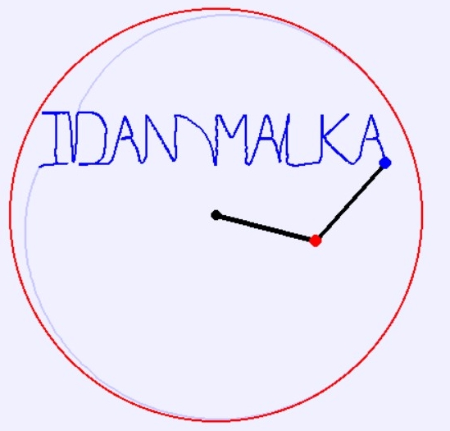
Control of Simulated Dynamic Planar Manipulator on a GUI
Project: Idan Malka
MEng Mechatronics, EEE UoM
Supervisor: Heath, William

Slide 2
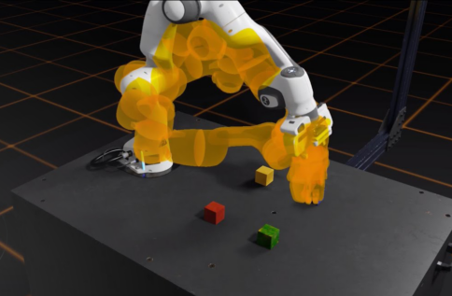
Robotic Simulation?
Source: NVIDIA Omniverse Experience for Robotics for NVIDIA Isaac Sim

Slide 3
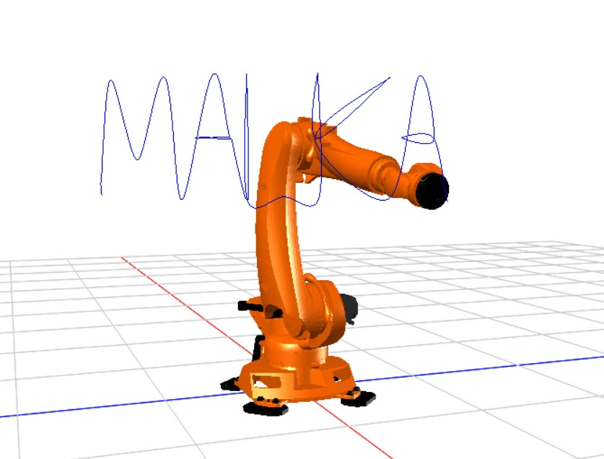
Background
Paid software:
easy, expensive
VS
Open-Source: Programming knowledge required, NOT friendly
MapleSim – KUKA Robot simulation

Slide 4
Technical Development

Slide 5
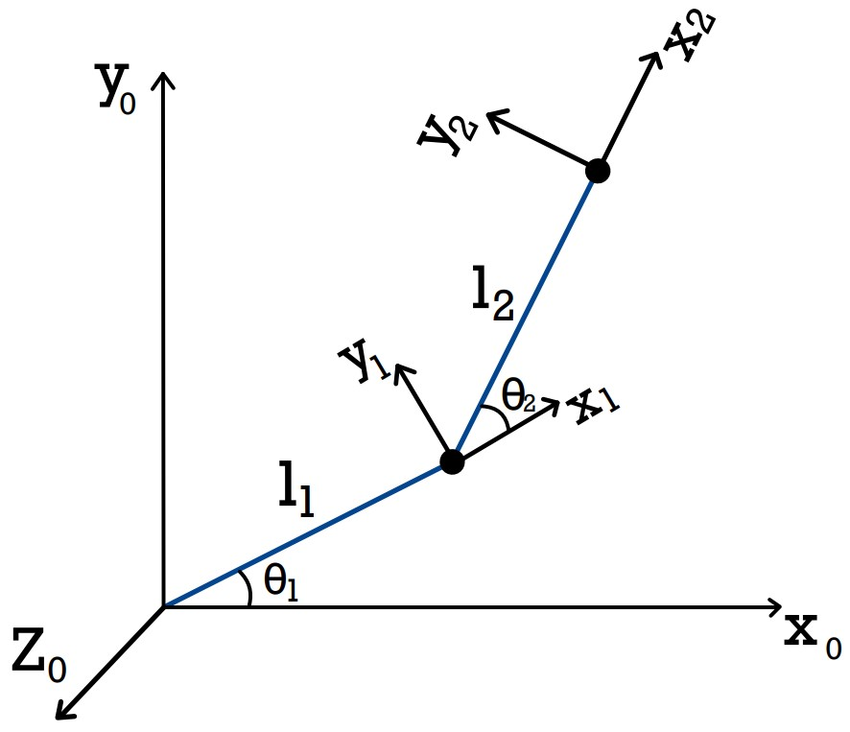
Configuration: 2 DOF RR Planar
DH Table
Link i | θ | d | a | α
1 | θ1 | 0 | L1 | 0
2 | θ2 | 0 | L2 | 0
Forward Kinematic
Angle To Tip
Diagram 2 DOF RR manipulator with frames

Slide 6
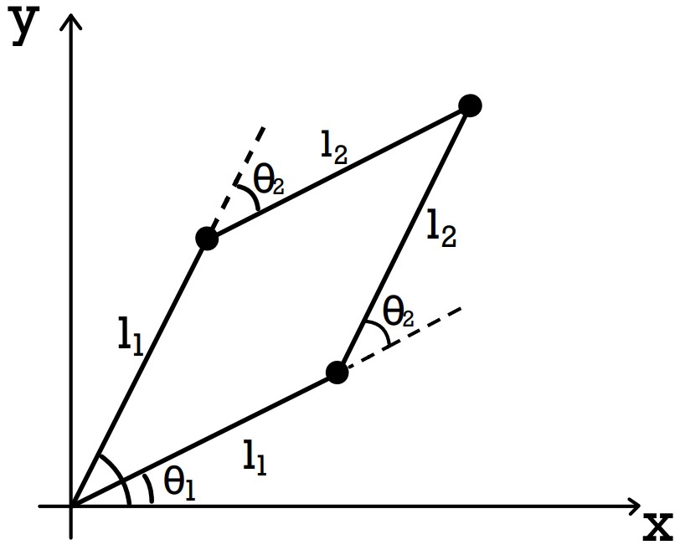
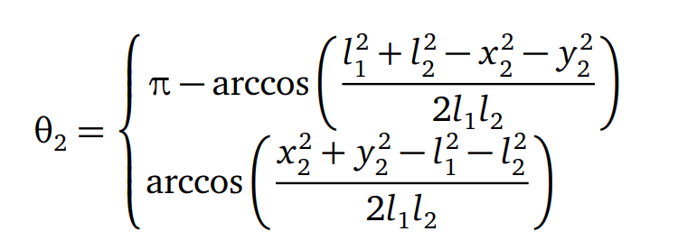
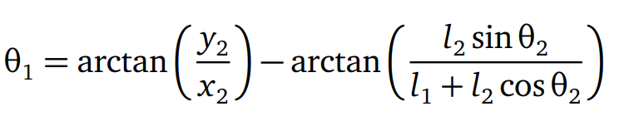
Inverse Kinematics – Analytic
Tip To Angles

Slide 7
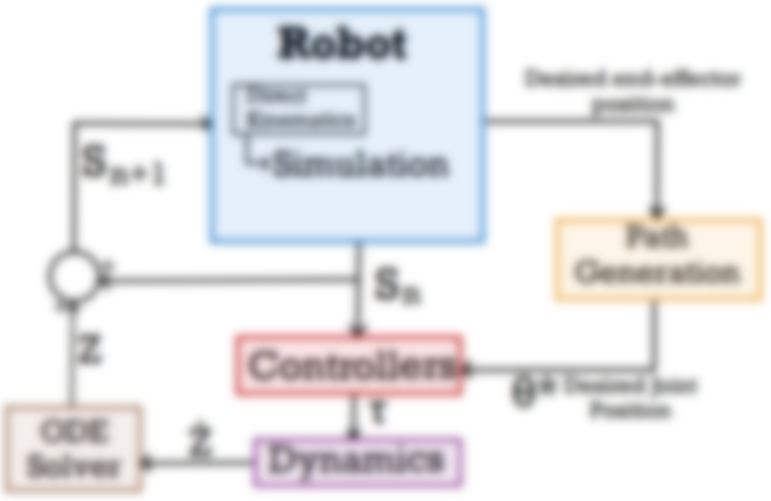
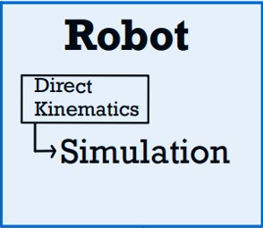
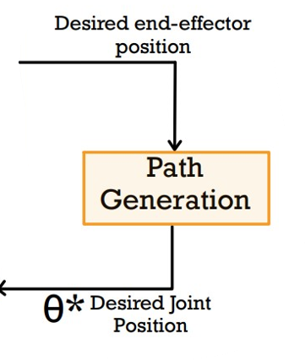
System Architecture

Slide 8
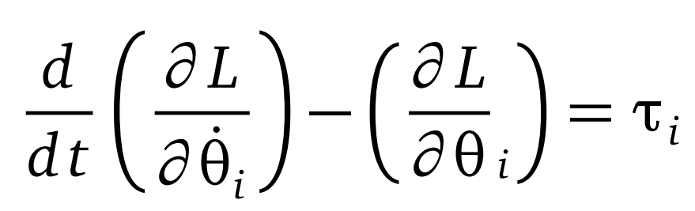
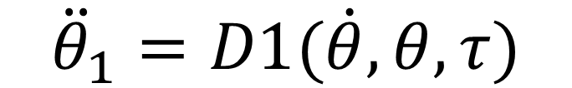
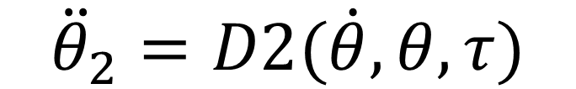
Dynamics – Lagrangian Method
Lagrangian = Kinetic - Potential
Angular Acceleration
$${\ddot{θ}}_{1}=D1(\dot{θ}, θ,τ)$$
$${\ddot{θ}}_{2}=D2(\dot{θ}, θ,τ)$$

Slide 9

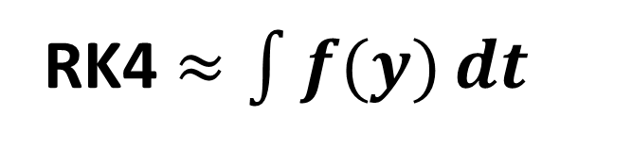
ODE Solver – 4° Runge-Kutta
Approximate integration
RK4 $≈\int{f(y)}dt$
Next State ?
$$y_{i+1}=y_{i}+RK4(y_{i},t_{i},h)$$

Slide 10
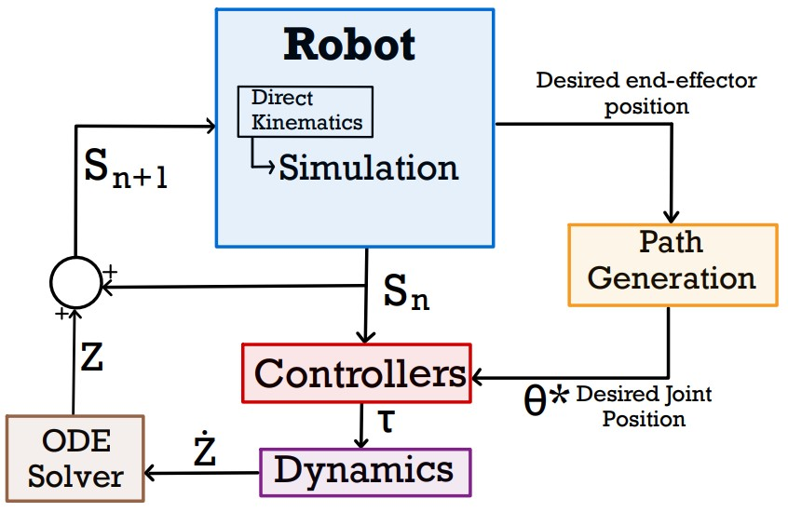

System Architecture

Slide 11
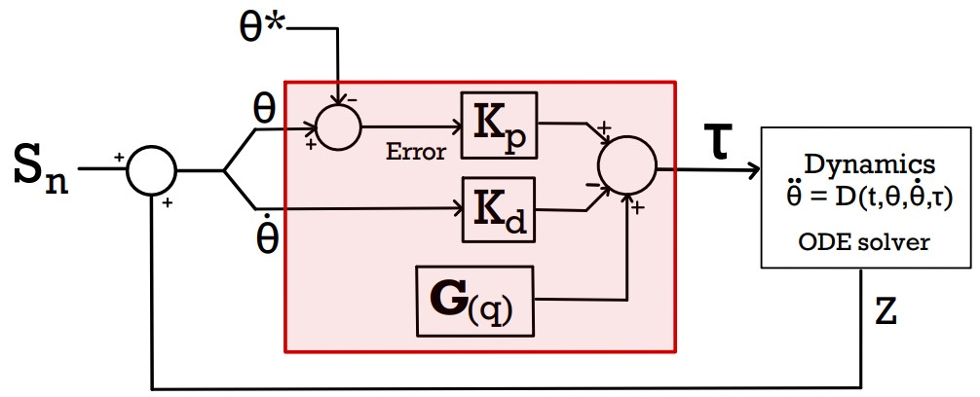
Robotic Control – PD Controllers

Slide 12
System Architecture - Complete

Slide 13
Reliable?

Slide 14
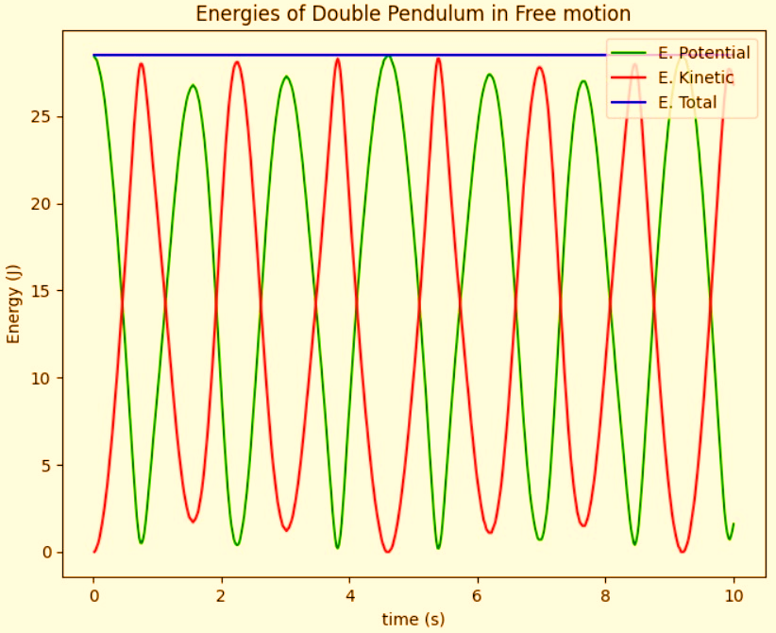
Free motion Testing
Law of Conservation
Test: Dynamics
Moving (E)
Max Error: 10^-4
Reliable Simulation!

Slide 15
Software Design of GUI

Slide 16
Software Implementation
Python 3.9
Simulation Testing & Math (Numpy + Math + MatplotLib)
Friendly GUI (Pygame)
Adaptable (>2 DOF)

Slide 17
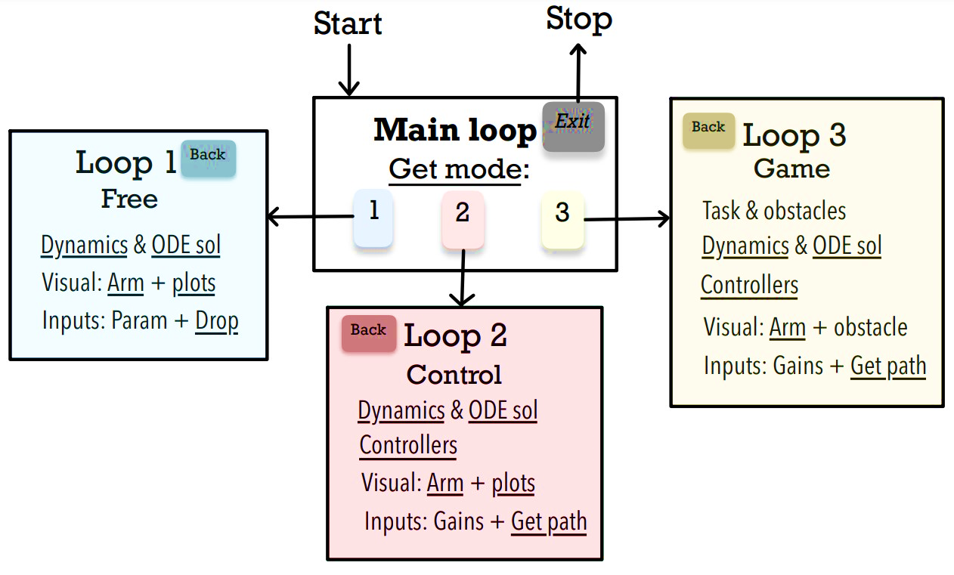
Software structure

